Slide 1
A Simple Baseline for Semi-supervised Semantic Segmentation with Strong Data Augmentation
ICCV 2021
발표자: 김병현
이미지처리팀:
김선옥, 김현진, 박재완, 안종식, 이찬혁, 현청천, 홍은기

Slide 2
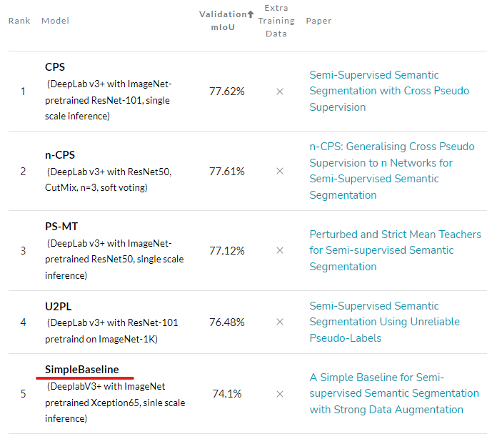


Simple Baseline
What is Simple Baseline??
Semi-Supervised semantic segmentation model
Ranked in 5th place for semi-supervised semantic segmentation on Cityscapes 12.5% labeled.
Dog
Cat
Labeled
Unlabeled
Example of Semi-supervised learning

Slide 3
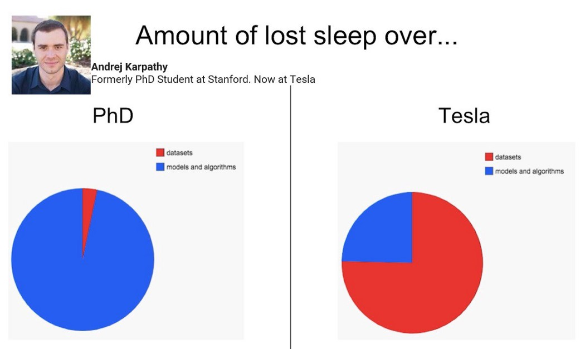
Expensive Labeling Cost in Deep Learning
Data Labeling can be a bottleneck ….
Datasets
Datasets
Model
Model
https://www.youtube.com/watch?v=y57wwucbXR8&t=512s&ab_channel=Databricks

Slide 4

Efforts to Reduce Labeling Cost
Training Deep Learning Model with Weak or Semi Supervision
Supervision
Weakly-Supervision
Dog
Cat
Dog
Cat
Dog
Cat
Cat
Dog
Labeled
No bounding box
Semi-supervision
Weakly Semi-Supervision
Dog
Dog
Cat
Cat
Cat
Dog
Labeled
Unlabeled
Labeled
No bounding box
Different types of object detection settings

Slide 5
Efforts to Reduce Labeling Cost
Training Deep Learning Model with Weak or Semi Supervision
Supervision
Weakly-Supervision
Dog
Cat
Dog
Cat
Dog
Cat
Dog
Cat
Labeled
No bounding box
Today’s Topic
Semi-supervision
Weakly Semi-Supervision
Dog
Dog
Cat
Cat
Dog
Cat
Labeled
Unlabeled
Labeled
No bounding box
Different types of object detection settings

Slide 6
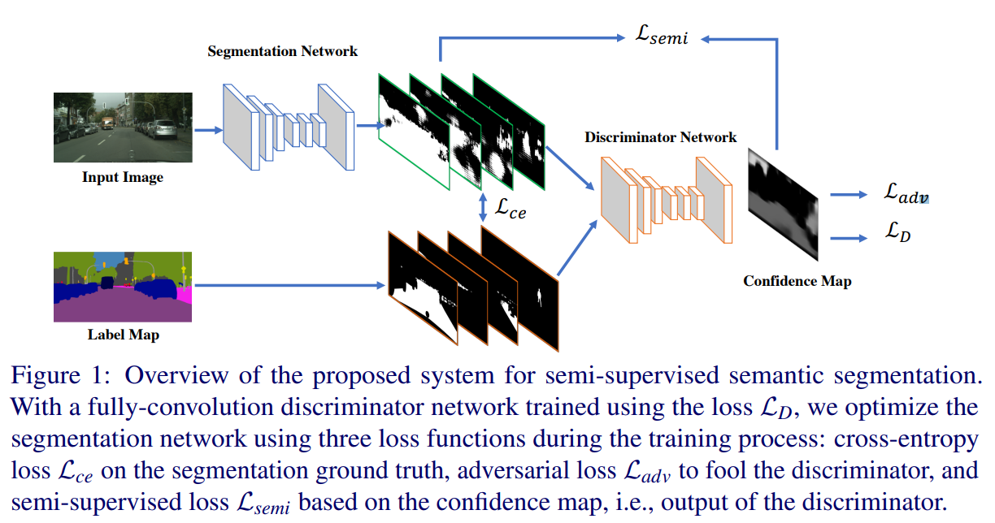
Previous Works
GAN-based Approaches
Adversarial Learning for Semi-Supervised Semantic Segmentation
Hung, W. C., Tsai, Y. H., Liou, Y. T., Lin, Y. Y., & Yang, M. H. (2018). Adversarial learning for semi-supervised semantic segmentation. arXiv preprint arXiv:1802.07934.

Slide 7
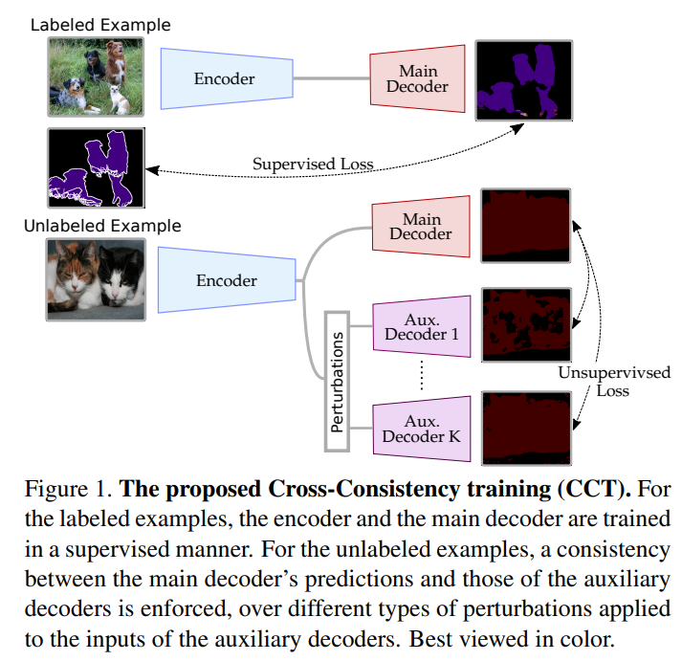
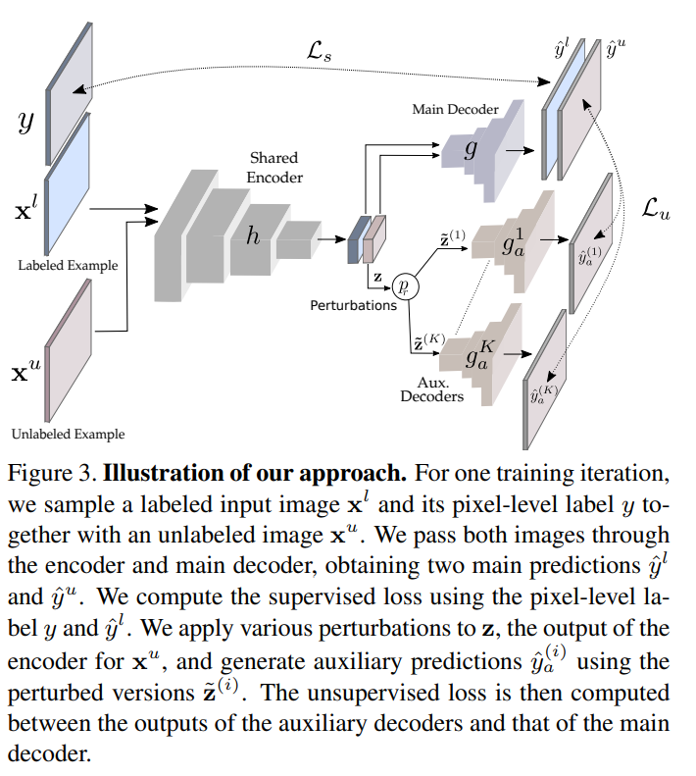
Previous Works
Consistency Regularization-based Approaches
Semi-Supervised Semantic Segmentation with Cross-Consistency Training
Ouali, Y., Hudelot, C., & Tami, M. (2020). Semi-supervised semantic segmentation with cross-consistency training. In Proceedings of the IEEE/CVF Conference on Computer Vision and Pattern Recognition (pp. 12674-12684).

Slide 8
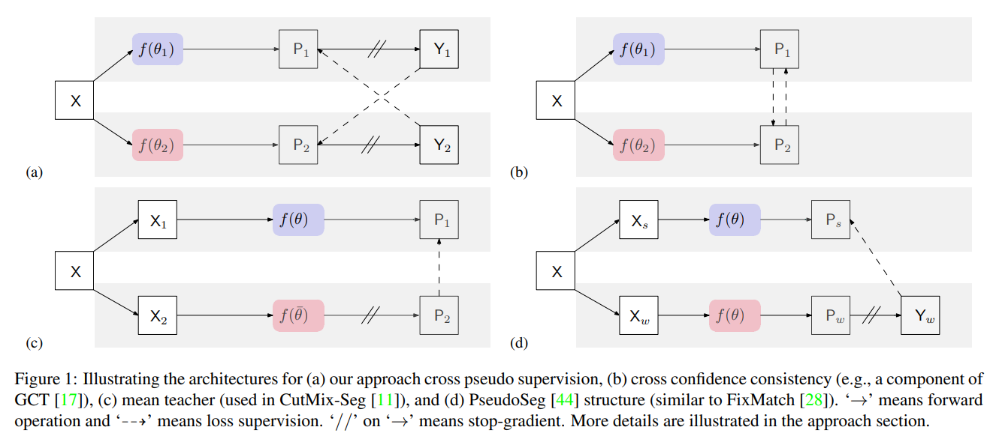
Previous Works
Consistency Regularization-based Approaches
Semi-Supervised Semantic Segmentation with Cross Pseudo Supervision (Not mentioned in the paper)
Hung, W. C., Tsai, Y. H., Liou, Y. T., Lin, Y. Y., & Yang, M. H. (2018). Adversarial learning for semi-supervised semantic segmentation. arXiv preprint arXiv:1802.07934.

Slide 9
Contribution of the paper
Effective and Efficient Semi-Supervision Framework
Strong Augmentation
Data-Distribution Specific Batch Normalization
Self-Correction Loss
State of the Art Performance
Cityscapes Dataset 1/8 (mIoU)
Baseline DeeplabV3+: 68.9%
Proposed Framework: 74.1%

Slide 10
Q & A
Q & A

Slide 11
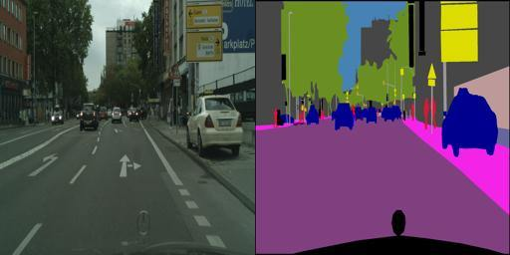
Prosed Framework
Labeled Data
Training
(Cross-Entropy Loss)
Teacher Model

Slide 12
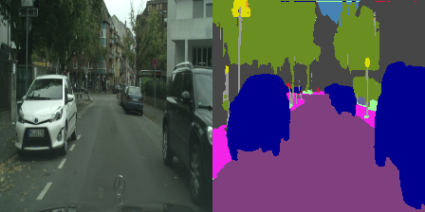


Prosed Framework
Training
(Self-Correction Loss)
Student Model
Weak
Augmentation
$${BN}_{w}$$
$${BN}_{s}$$
Labeled Data
Strong
Augmentation
Training
(Cross-Entropy Loss)
Soft
Augmentation
Teacher Model
Unlabeled Data
Pseudo Label
(One-hot)
Prediction

Slide 13
Prosed Framework
Training
(Self-Correction Loss)
Student Model
Weak
Augmentation
$${BN}_{w}$$
$${BN}_{s}$$
Replace
Labeled Data
Strong
Augmentation
Training
(Cross-Entropy Loss)
Soft
Augmentation
Teacher Model
Unlabeled Data
Pseudo Label
(One-hot)
Prediction

Slide 14
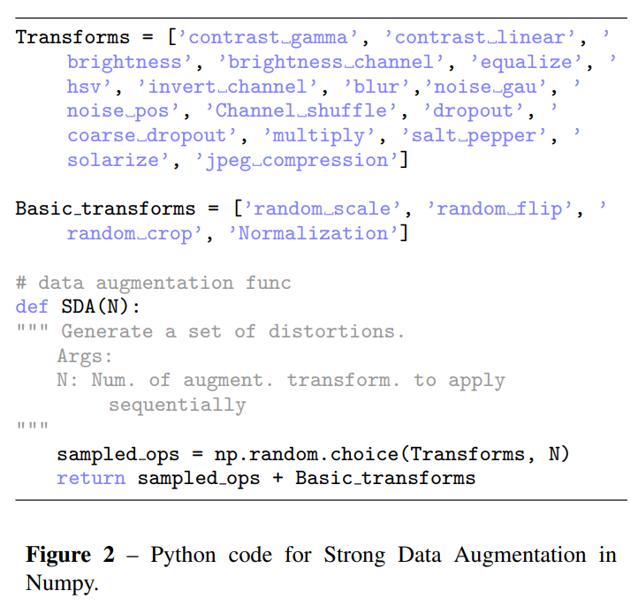
Strong Augmentation

Slide 15
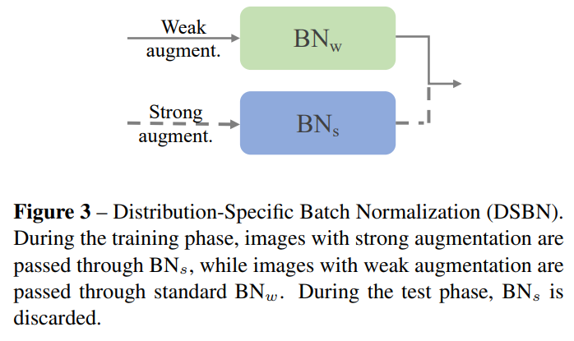
Distribution-Specific Batch Normalization

Slide 16
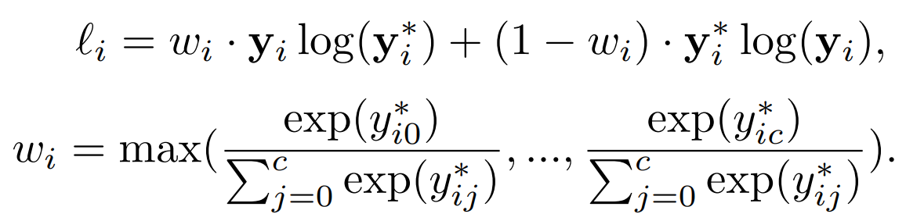



Self-Correction Loss
Self-Correction Loss
: Prediction
: Pseudo-Label
: Dynamic Weight

Slide 17
Q & A
Q & A

Slide 18
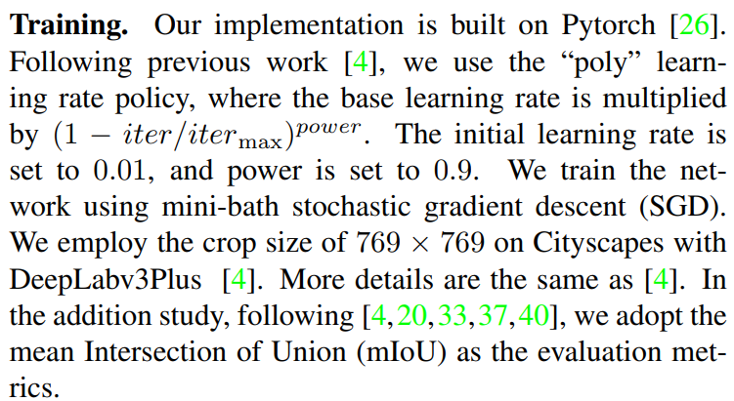
Experiments
Training Details

Slide 19
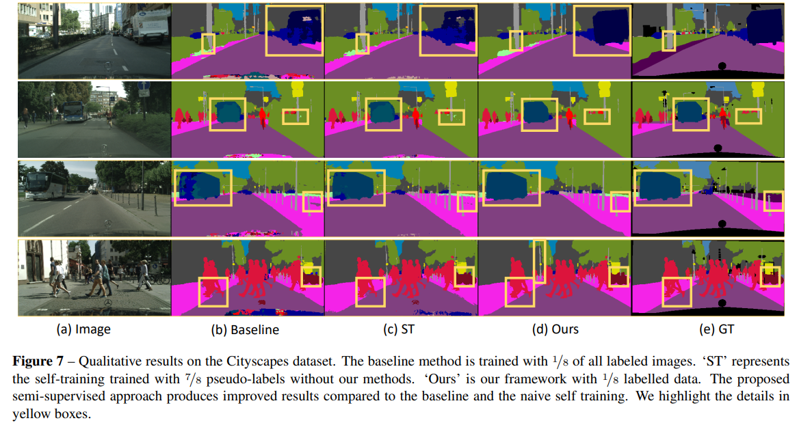
Experiments
Qualitative Comparison

Slide 20
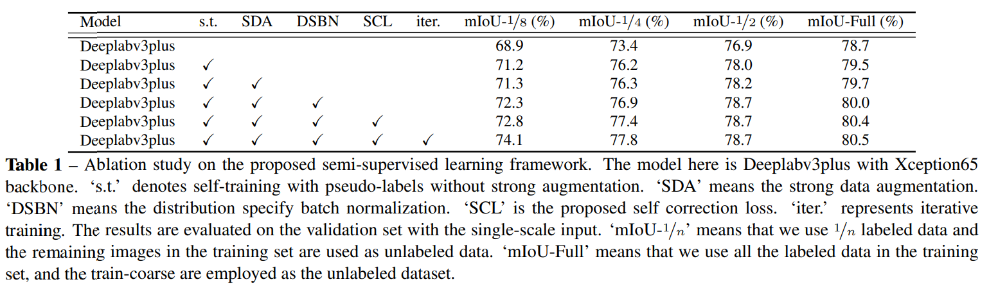
Experiments
Ablation Study - Overall

Slide 21
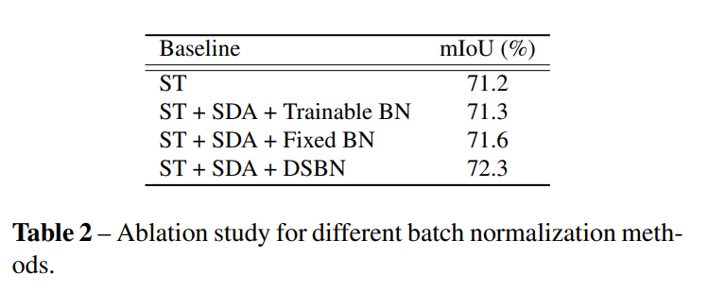
Experiments
Ablation Study - DSBN

Slide 22
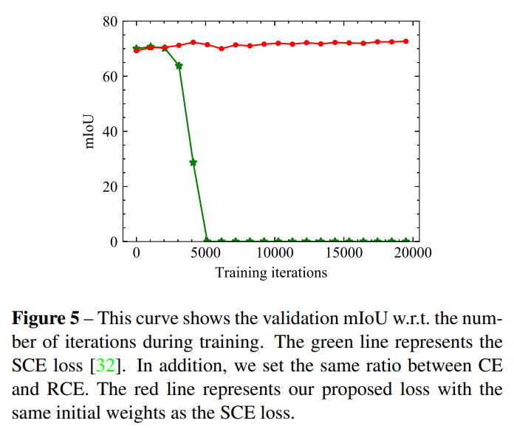
Experiments
Impact of Self-Correction Loss

Slide 23
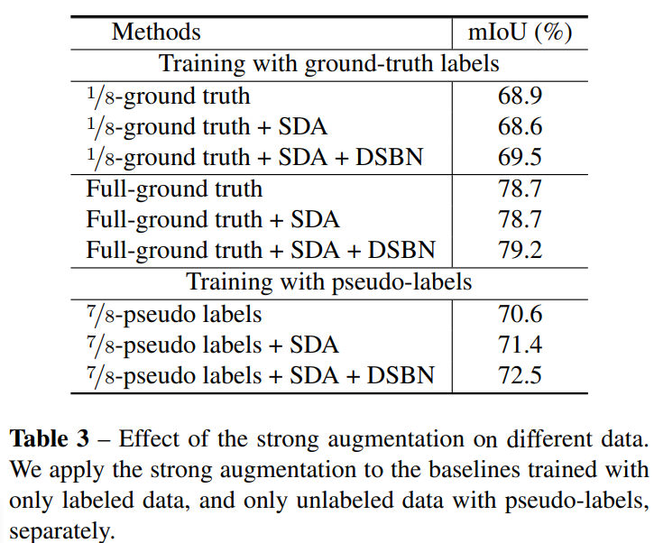
Experiments
Ablation Study – Strong Augmentation

Slide 24
Q & A
Q & A

